Slide 1
Digital twin for energy industry
Wind Turbine Modeling Workshop
Adrien Hirvoas, Ph.D. - FEM
ISEN Yncréa Ouest
January 16th-19th, 2023

Slide 2
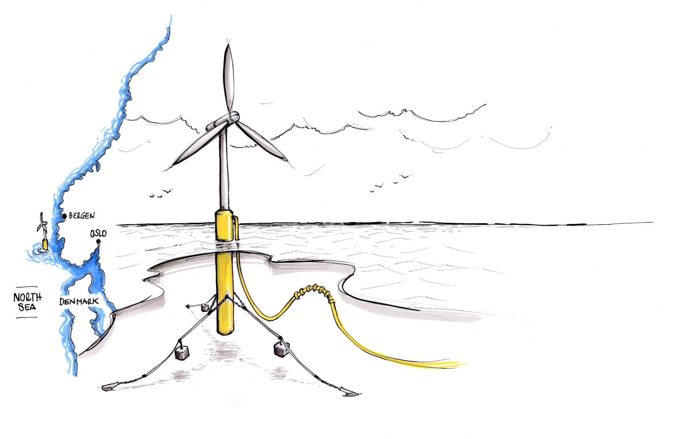
Wind Turbine Modeling Workshop - Agenda
Day 1: Welcome and Introductions Wind Turbine Modeling Overview Overview of OpenFAST Practical work: Installation Inputs and outputs workflow OpenFAST Modules OpenFAST tool: python-toolbox Practical work: Practicing Run your first simulation | Day 2: OpenFAST reminder OpenFAST tutorial Practical work: Floating Offshore Wind Turbine Post-Processing A digital twin approach Conclusion & Question

Slide 3
Day 1 - Agenda
Welcome and Introductions
Wind Turbine Modeling Overview
Overview of OpenFAST
OpenFAST modules
Practice – Onshore wind turbine

Slide 4





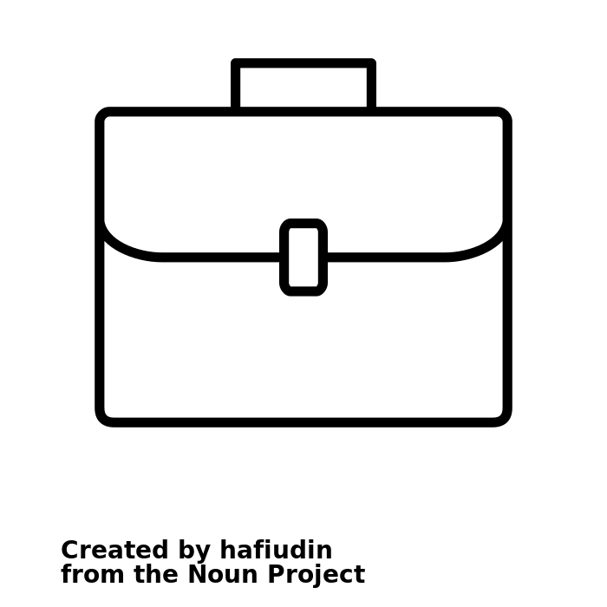
Welcome and Introductions
Myself in short
Personal Profile
Education
Research engineer with a focus on mathematics applied to floating offshore wind turbine
Engineering Diploma in Mechanical Engineering
Master of Research
Ph.D. in applied Mathematics
Contact info
Work Experience
Adrien Hirvoas
LinkedIn: adrien-hirvoas
Email: adrien.hirvoas@france-energie-marines.org
7 years of R&D in wind turbine system
Research institutes: IFPEN / FEM

Slide 5
Welcome and Introductions
French National Research Institute fully dedicated to Offshore Renewable Energies
Staff 70
Since 2012
€6M budget in 2021 100% allocated to R&D
Headquarters in Brest Offices in Le Havre, Nantes and Marseille
Institute supported by France 2030 investment plan
France Energies Marines (FEM) in short

Slide 6




Welcome and Introductions
FEM - Scientific and technological roadmap
SITE CHARACTERISATION
Spatialisation of observations
Characterisation of sea states
Wind characterisation at sea
Climate change
Hydrosedimentary processes
SYSTEMS DESIGN AND MONITORING
Structure, mooring and electrical cable
Hydrodynamic and structural coupling
Digital twins and in-service monitoring
Technological innovation
4 cross-cutting and complementary R&D programmes
ENVIRONMENTAL INTEGRATION
Effects on ecosystem compartments
Changing scale in terms of socio-ecosystem, space and time
Tools for environmental integration
FARM OPTIMISATION
Farm architecture
Grid integration (hydrogen...)
Installation, operation and maintenance

Slide 7
Welcome and Introductions
About this workshop
A GitHub repository is provided with some simulation folder and slides
2 x 3 hours – 08/03/2023 and 13/03/2023
Don’t hesitate to ask questions (even during the presentation)
Objectives
Clarify the concept of Wind Turbine Modeling
Clarify the concept of Digital Twin
Allow you to build your first wind turbine numerical model

Slide 8
Day 1 - Agenda
Welcome and Introductions
Wind Turbine Modeling Overview
Overview of OpenFAST
OpenFAST modules
Practice – Onshore wind turbine

Slide 9
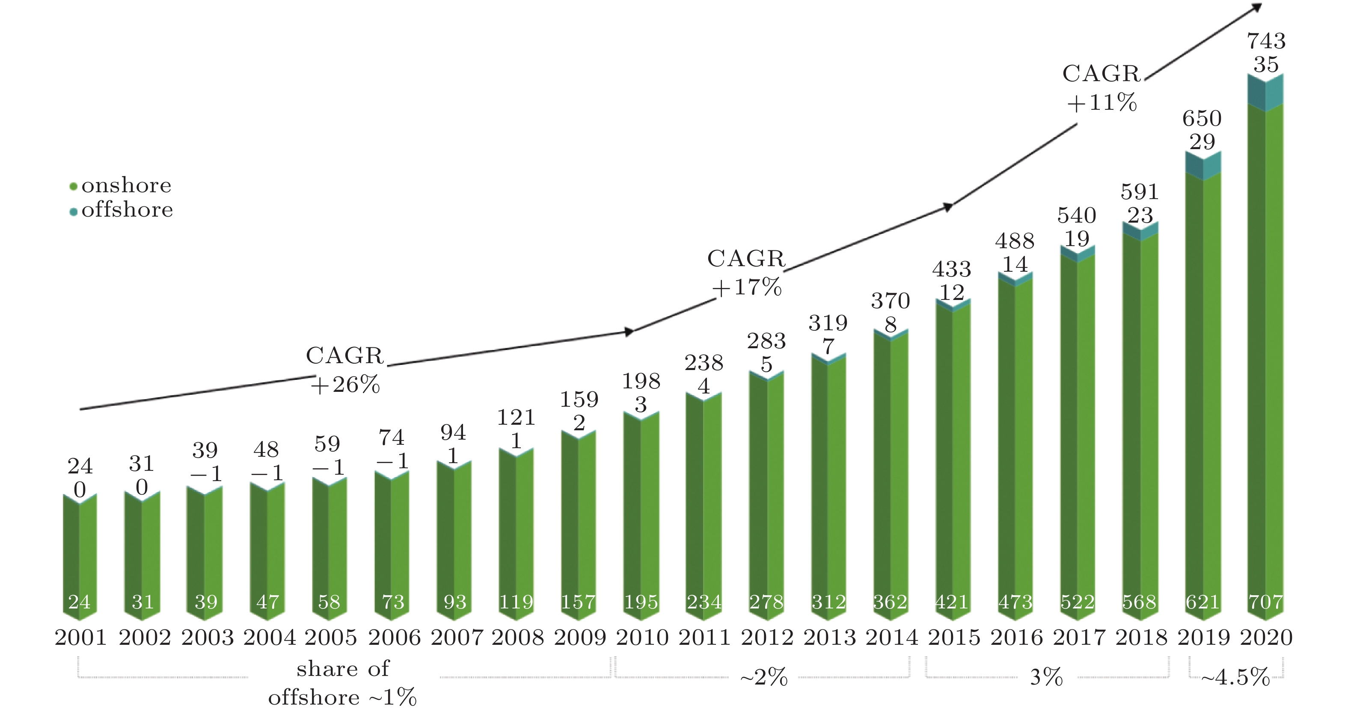
Wind Turbine Modeling Overview
Development of wind capacity
2001~2020
Wind Turbines are as Large as civil structures
but are active machines

Slide 10
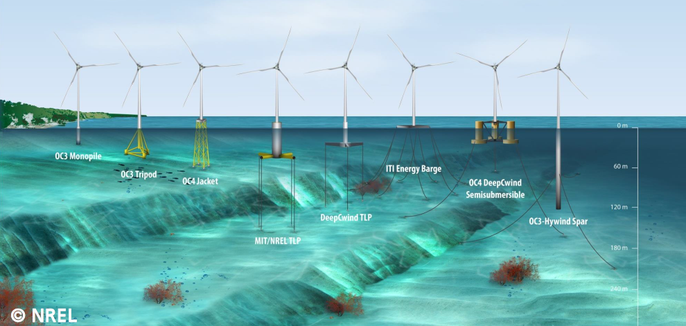
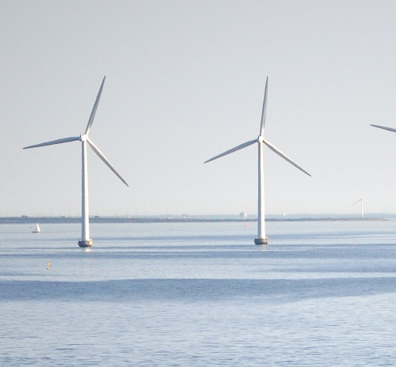
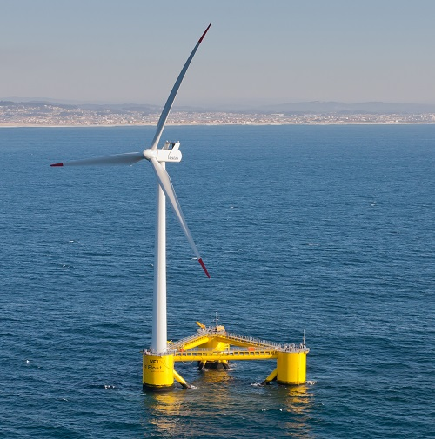
Wind Turbine Modeling Overview
Offshore wind turbines (still in development)
Fixed wind turbines
Floating wind turbines

Slide 11
Wind Turbine Modeling Overview
Why?
Lower wind cost of energy requires technology advancement through improved engineering capability founded on physics.
What?
Improved physics-based engineering design competence and software needed to advance wind energy technology.
How?
Use the knowledge, data, and results from broader wind research to improve physics-based engineering design competence and software.
Physic-Based
Knowledge
Real-World
Data
Engineering Design Competence and Models
Advanced Wind
Energy
Technology at
Lower Cost

Slide 12
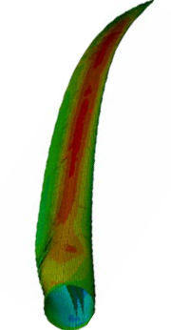
Wind Turbine Modeling Overview
Coupling Between Fluids, Structures, and Controls
Controls
Aerodynamics
Hydrodynamics
Structures

Slide 13

Wind Turbine Modeling Overview
What is a Digital Twin ? (For you)
An online survey: https://forms.gle/QMrxHDSeP187mjAS8
Possible responses:
A fully defined model, able to simulate the full behavior of an asset
A model similar to a real system that receives data from sensors on the real asset
A 3D model
Simulation of a manufacturing asset
A moving model
All of the above
I don’t know

Slide 14
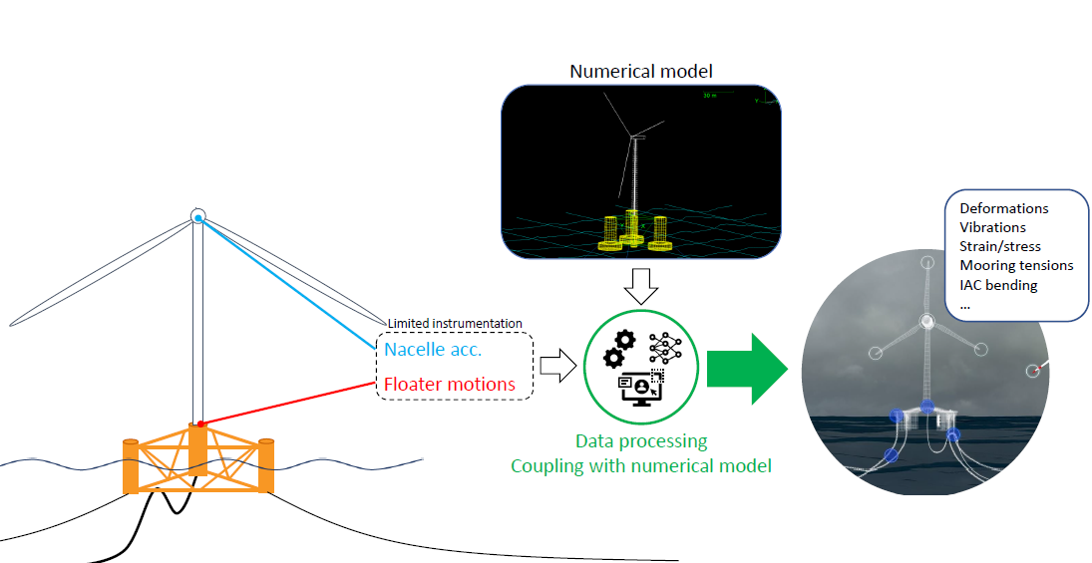
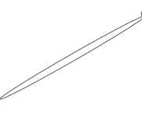
Wind Turbine Modeling Overview
Digital Twin - Wind Turbine
What for ?
Improve availability
Reduce operational expenditure (OPEX)
Streamline inspection
Anticipate life extension
Improve future designs

Slide 15
Day 1 - Agenda
Welcome and Introductions
Wind Turbine Modeling Overview
Overview of OpenFAST
OpenFAST modules
Practice – Onshore wind turbine

Slide 16
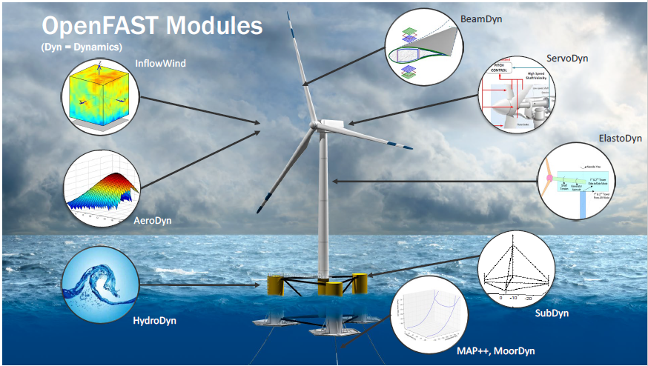
Overview of OpenFAST
OpenFAST: An Open-Source Tool for Wind Turbine Physics-Based Engineering Modeling
An open-source wind turbine physics-based engineering tool
Mathematical models are implemented in distinct modules & interconnected to solve for the global, coupled, dynamic response of a system
Currently an open-source code-development community for physics-based engineering models

Slide 17
Overview of OpenFAST
OpenFAST - inputs and outputs
INPUTS:
one main file (extension .fst) which references other files
OUTPUTS:
one data file (.out or .outb) with time series of selected output channels
optional files: summary (.sum), echo (.ech), linearization (.lin), visualization (vtk)
Main.fst
ElastoDyn.dat
Main.out
ED_Tower.dat
Time (s) | Rotor Speed (rpm) | … | Channel[n] (unit)
0 | 5.0
0.1 | 4.9
… | …
tMax | 5.5
ED_Blade.dat
OpenFAST executable
AeroDyn.dat
AD_Blade.dat
Polar.dat
….
Main*.sum
Main*.ech
Main*.lin
vtk*/
…

Slide 18
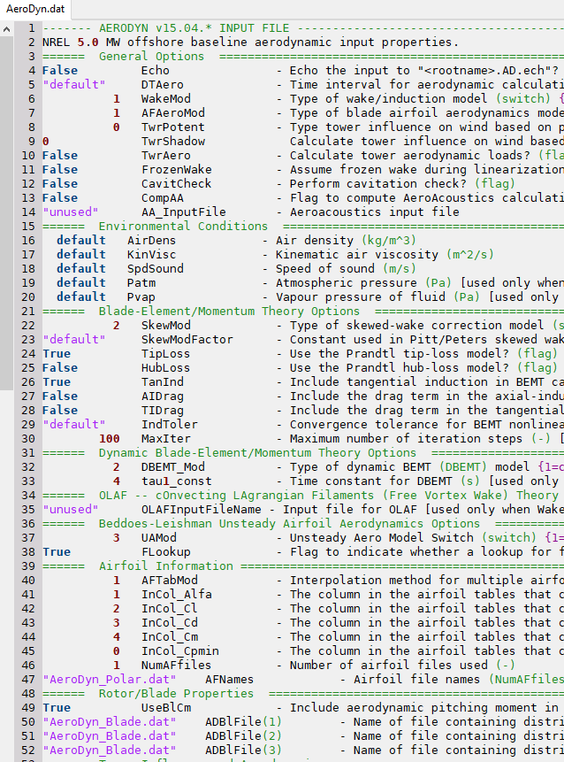
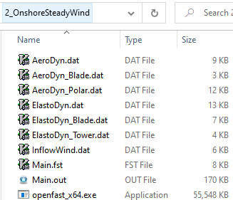
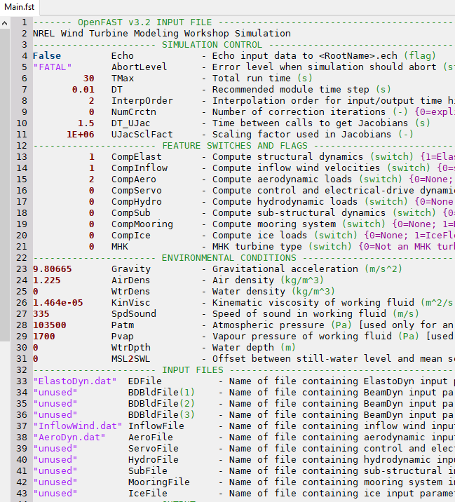
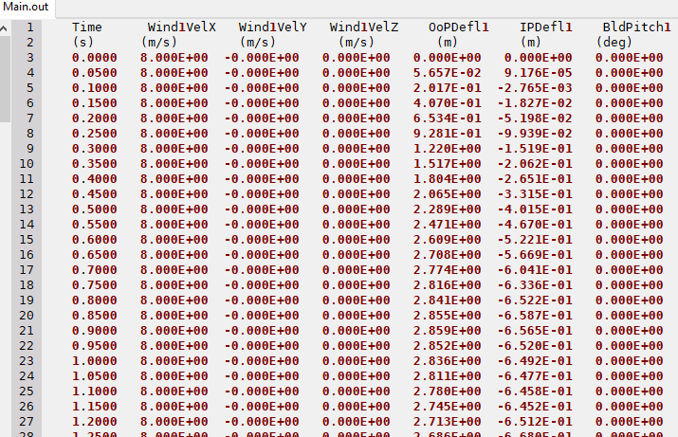
Overview of OpenFAST
OpenFAST - inputs and outputs (in practice)
Typical folder:
INPUTS
OUTPUT
EXE

Slide 19
Day 1 - Agenda
Welcome and Introductions
Wind Turbine Modeling Overview
Overview of OpenFAST
OpenFAST modules
Practice – Onshore wind turbine

Slide 20


OpenFAST modules
Additional ElastoDyn input files (.dat)
Additional AeroDyn input files (.dat)
Wind data files (.wnd, .bts, hh, etc…)
Bladed-style external controller (.dll)
Additional HydroDyn input files (.dat)
Primary (.dat)
ElastoDyn | Structural dynamics
Primary (.dat)
AeroDyn | Aerodynamics
Primary (.dat)
InflowWind |
Wind Inflow
Primary (.dat)
ServoDyn |Control and Electrical Drive Dynamics
Primary (.dat)
HydroDyn |Hydrodynamics
Primary (.dat)
MAP++ |Quasi static Mooring Dynamics
OpenFAST driver
Primary (.fst)
Linearization (.lin)
Visualization (.vtp)
Times Series (.out, .outb)

Slide 21
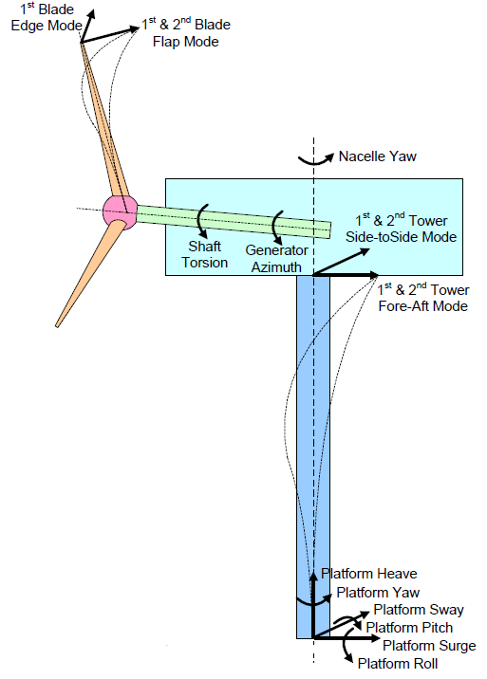
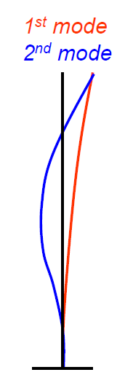
OpenFAST modules
ElastoDyn
Computes structural response as part of the aero-hydro-servo-elastic solution
Combined modal & multi-body representation through 24 Degrees of Freedom
Multi-body: platform, nacelle, generator, gears, hub, tail
Modal: blades, tower
Blade & tower modeling assumptions:
Bernoulli-Euler beams
Straight & isotropic
Bending only
Small to moderate deflections
Modal
representation

Slide 22
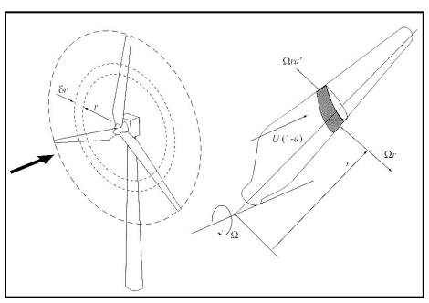
OpenFAST modules
AeroDyn
Computes aerodynamics (lift, drag, pitch) as part of the aero-elastic solution
Wind-inflow input:
Uniform, unsteady
Turbulent (TurbSim)
Wake modeling:
Blade Element Momentum (BEM) theory
Dynamic wake (DBEMT)
Dynamic stall modeling:
Beddoes-Leishman (semi-empirical)
Tower drag & influence on wind
Schematic representing an annular actuator in BEM theory from [8]

Slide 23
OpenFAST modules
InflowWind
Undisturbed wind inflow:
Steady
Uniform, but time-varying, e.g., deterministic gusts from IEC (IECWind)
Full-field (FF) turbulence (TurbSim, Mann)
User-defined

Slide 24
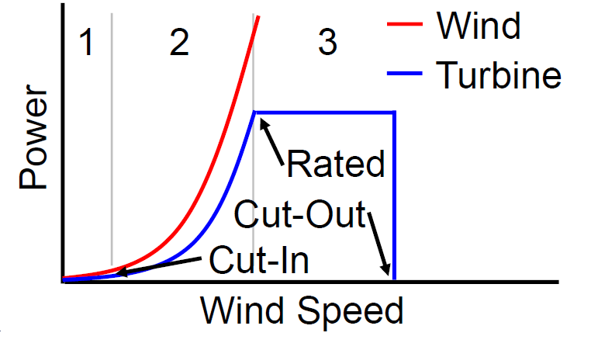
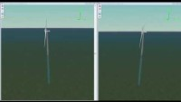
OpenFAST modules
ServoDyn
Control and Electrical Drive Dynamics
Modeling: standard conventional pitch controller
Two main operating regimes:
Maximum Power Regime
Constant Power Regime
Floating context: problems due to negative damping

Slide 25
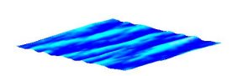
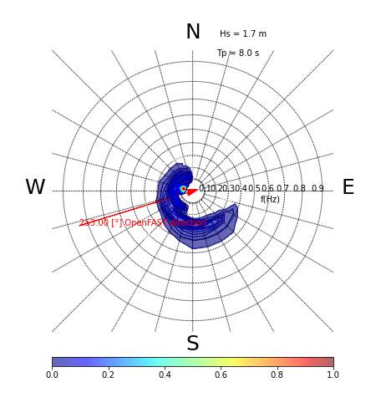
OpenFAST modules
HydroDyn
Computes wave-kinematics & hydrodynamics as part of the hydro-elastic solution
Waves & Current
Wave kinematics:
Linear regular (periodic)
Linear irregular (stochastic):
Wave direction & directional spreading
Steady sea currents:
IEC-style sub-surface, near surface, & depth-independent
Or user-defined
Hydrodynamic Loading
Strip theory (Morison)
Potential flow (WAMIT):
1st and 2nd-order (QTF or Newman’s approximation) theory
Hybrid combination of these two
Multi-Directional Sea State
IEC Sea Currents

Slide 26
OpenFAST modules
MAP++
Quasi static
Multi-segmented array of taut or catenary lines
Elastic stretching
Apparent weight of lines
Clump weights & buoyancy tanks
Seabed friction
Nonlinear geometric
MAP++ module
Constraint States:
Displacements
Velocities
Parameters:
Line properties
Line connectivity
Gravity
Inputs:
Platform displacements
Outputs:
Line tensions
Line displacements

Slide 27
Day 1 - Agenda
Welcome and Introductions
Wind Turbine Modeling Overview
Overview of OpenFAST
OpenFAST modules
Practice – Offshore wind turbine

Slide 28

Practice – Offshore wind turbine – Google Colab
What is Google Colab?
Google Colab which stands for Google Colaboratory is a cloud platform
provided by Google to run Python Notebook’s without need to install
anything on your local machine.
Features of Google Colab
Zero Setup Required
Free GPU Access
Pre-installed Libraries
Accessing Google Colab
https://github.com/Ahirvoas/Training-Day1/blob/main/Tutorial_day1.ipynb

Slide 29
Annex

Slide 30



Annex – Local Installation
Prerequisites
The open-source Python distribution platform ANACONDA
To download the individual edition: click here
Installation
Windows | macOS | Linux
Use the precompiled executable named openfast_x64.exe in the shared folder Test by opening a command prompt, moving into the directory containing the executable, and running a simple test command: | Conda Installation Open an anaconda prompt command Install OpenFAST in a new environment
# conda create a new environment
conda create -- clone base –n openfast_env
Conda activate openfast_env
# install OpenFAST through the conda channel
conda install –c conda-forge openfast==2.0.0
# Test OpenFAST
which openfast
cd path\to\folder
openfast_x64.exe /h

Slide 31
Annex – Local Installation
Let’s practice – installation
Windows | macOS | Linux
Use the precompiled executable named openfast_x64.exe in the shared folder Test by opening a command prompt, moving into the directory containing the executable, and running a simple test command: | Conda Installation Open an anaconda prompt command Install OpenFAST in a new environment
# conda create a new environment
conda create -- clone base –n openfast_env
Conda activate openfast_env
# install OpenFAST through the conda channel
conda install –c conda-forge openfast==2.0.0
# Test OpenFAST
which openfast
cd path\to\folder
openfast_x64.exe /h

Slide 32
Annex – Local Installation
python-toolbox
Tools to read/write, preprocess and postproces OpenFAST files
https://github.com/OpenFAST/python-toolbox
As much as possible independent of OpenFAST version
Installation:
git clone http://github.com/OpenFAST/python-toolbox (or download the GitHub repository)
conda activate openfast_env
cd python-toolbox
python -m pip install –e .

